Slide 1
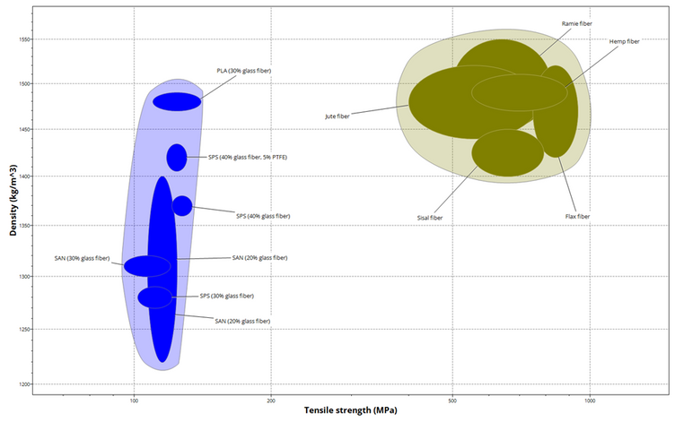


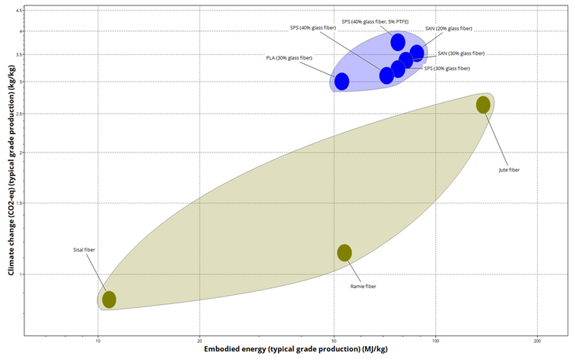
Cat Teaser Wand LCA
Stephen Hussaini
24813722
Eco-Optimized Materials & Process Selection
Materials Selection
Wand (Handle)
ABS Plastic • 0.05 kg
96.8% energy
String (Eco)
Hemp Fiber • 0.015 kg
Biodegradable, 3.2% energy
Key Decision: Replaced Nylon (90% downcycle) with Hemp fiber for string component to minimize end-of-life impact while maintaining functionality and cost objectives.

Slide 2
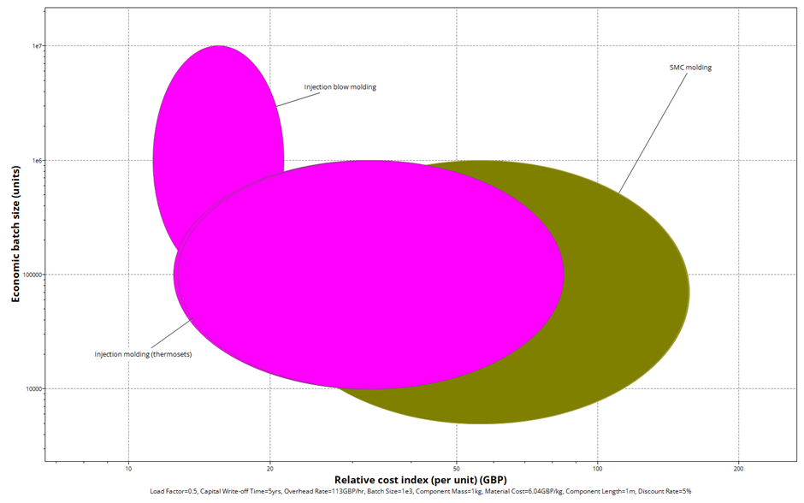

Process Selection: Hemp String
Design Constraints Met
•Function: Flexible cord connecting teaser to wand
•Sustainability: Biodegradable & eco-friendly
•Scale: 50,000 units @ 0.015 kg per unit
•Process: Natural fiber spinning/braiding (primary, continuous)
Batch Size: 50,000 Units
Thickness: 1 - 3mm
Manufacturing Energy: Hemp production at 8.1e+03 MJ total (3.2% of product energy) vs. Nylon at significantly higher impact
Tolerance: ±0.5 mm

Slide 3
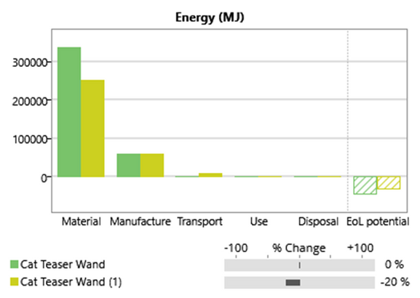
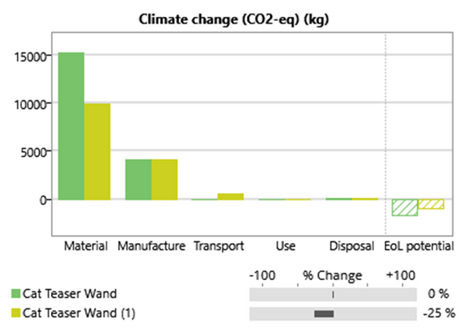
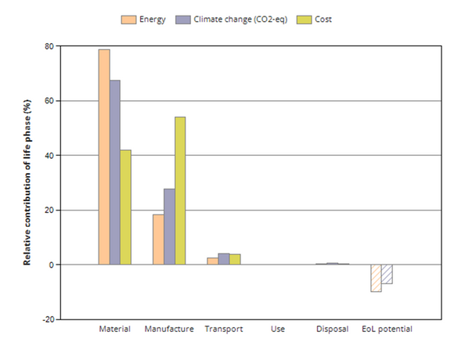

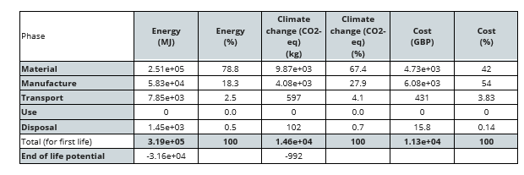
LCA Results: New vs. Original Design
✓ Improvement Areas
•String: Nylon → Hemp (biodegradable)
•Reduced synthetic fiber end-of-life impact
•Maintained cost & performance targets
⚠ Maintained Components
•Wand: ABS plastic (96.8% energy)
•Downcycling end-of-life (80%)
•Total mass: 0.085 kg per unit
Strategic Outcome: 3.2% energy reduction via material substitution while prioritizing biodegradability in end-of-life phase. Further optimization possible by transitioning wand to bio-based polymer (Phase 2).

